Slide 1
Diagrams for Documentation
Organized by Section and Topic

Slide 2
Ledger Concept
Ledger, World state, Blockchain, Block, Transaction

Slide 3
Diagram 1
 | Ledger
 | World State
 | Blockchain
 | L comprises B and W
 | B determines W
L
W
W
L
B
B
B
L
W
W
B
Notes:
The Visual Vocabulary expressed in facts
Ledger L comprises blockchain BC and World State WS. Blockchain BC defines World State WS. Also expressible as: World state WS is derived from blockchain BC.

Slide 4
Diagram 2
 | Blockchain
 | Block
 | Block header
 | Block data
 | Transaction
 | Block metadata
 | H2 is chained to H1
B
B1
B0
B1
B2
B3
H0
H1
H2
H3
H3
D0
D1
D2
D3
D1
(genesis)
T1
T2
T3
T4
T5
T6
T7
T8
T9
T5
M0
M1
M2
M3
M3
B
H1
H2
Notes:
The Visual Vocabulary expressed in facts
In this blockchain there exists a block 1, 2 and 3.
Block 1 has block header Bhr1.
The blockdata Dat1 of block 1 consists of transaction txn1, txn2, txn3 and txn4.
Block 1 has as metadata Met1. Blockheader 2 is chained to blockheader1. Note: this could also be expresses as; the value of the field hash of previous block in block 2 is equal to the value of the hash of block 1 Definition (emphasis on semantics): Transaction as used above means the union of the proposal hash, the transaction response from the endorser, the Read-Write set and the signatures of all endorsers. Definition (emphasis on progressive disclosure): Transaction as used above means the union of the transaction header, the list of endorsers and the endorser’s response.

Slide 5
Diagram 3
 | Ledger world state
 | A ledger state with key=K. It contains a set of facts expressed as a simple value, V. The state is at version 0.
 | A ledger state with key=K. It contains a set of facts expressed as a set of key-value pairs {KV}. The state is at version 0.
W
{key=K, value = V }
version=0
{key=CAR1, value=Audi} version=0
{key= CAR2, value = {type: BMW, color: red, owner: Jane}} version=0
W
{key=K, value = {KV} }
version=0

Slide 6
Diagram 4
H2
 | Block header
 | Block number
 | Hash of current block transactions
 | Copy of hash from previous block
 | V2 is detailed view of H2
B2
(block number) 2
H2
H2
D2
2
T5
T6
T7
CH2 (current block hash)
CH2
PH1 (previous block hash)
PH1
M2
H2 V2
Notes:
The Visual Vocabulary expressed in facts
Blockheader Bhr1 of block 1 consists of block number 1, the hash of the previous block and the hash of the current block.

Slide 7
Diagram 5
T4
H4
 | Transaction
 | Header
 | Signature
 | Proposal
 | Response
 | Endorsements
 | V4 is detailed view of T4
T4
B1
S4
H4
H1
D1
S4
P4
T1
T2
T3
T4
P4
R4
R4
M1
E4
E4
T4 V4
Notes:
The Visual Vocabulary expressed in facts
The transaction T1 in blockdata Dat1 of block B1 consists of transaction header Txnhr1, the list of endorsers Endlst1 and the endorser response Res1.

Slide 8
Diagram 6
key=CAR3, value={color: yellow, make: Volkswagen, model: Passat, owner: Max} version=0
key=CAR2, value={color: green, make: Hyundai, model: Tucson, owner: Jin Soo} version=0
key=CAR1, value={color: red, make: Ford, model: Mustang, owner: Brad} version=0
key=CAR0, value={color: blue, make: Toyota, model: Prius, owner: Tomoko} version=0
W
L
0
1
(genesis)
T1
T2
T3
T4
B
Notes:
Visual vocabulary
The field hash of the previous block in block 0 (also known as Genesis block) has the value nil; the value of the hash of block 0 is 003.
The field hash of the previous block in block 1 has the value 003; the value of the hash of block 1 is 007.
Transaction T1 is committed as the first transaction into block 1; the contents of transaction T1 is: Car0 is currently of color blue; CAR0 is made by Toyota and is of model Prius; Car0 is currently owned by Tomoko.
Transaction T2 is committed as the second transaction into block 1; the contents of transaction T2 is: Car1 is currently of color red; CAR1 is made by Ford and is of model Mustang; Car1 is currently owned by Brad.
Transaction T3 is committed as the third transaction into block 1; the contents of transaction T3 is: Car2 is currently of color green; CAR2 is made by Hyundai and is of model Tucson; Car2 is currently owned by Jin Soo.
Transaction T4 is committed as the fourth transaction into block 1; the contents of transaction T4 is: Car3 is currently of color yellow; CAR3 is made by Volkswagen and is of model Passat; Car3 is currently owned by Max.

Slide 9
Network Concept
Network, Consortium, Organization, Channel, Policy, Configuration

Slide 10
Diagram 1.0
S5
S5
S6
S6
A1
A2
A3
P1
P2
P3
1
1
2
2
L1
1
L1
1
2
L2
2
L2
R1
R4
O4
_{NC4}
0
0
1
2
C1
CA4
C2
R1
R2
R2
R3
CA1
CA2
CA3
N
1
_{CC1}
_{CC2}
2

Slide 11
Diagram 1.1
A1
A2
A3
S5
S5
S6
S6
1
1
2
P1
P2
P3
L1
1
L1
1
2
L2
2
L2
CA4
R1
R2
R2
R3
R1
R4
O4
CA1
CA2
CA3
_{CC1}
_{CC2}
_{NC4}
0
N
1
2
0
1
2

Slide 12
Diagram 2
R4
O4
_{NC4}
0
0
CA4
N

Slide 13
Diagram 2.1
R1
R4
O4
_{NC4}
0
0
CA4
CA1
N

Slide 14
Diagram 3
X1
R1
R2
R1
R4
O4
_{NC4}
0
0
CA4
CA1
CA2
N

Slide 15
Diagram 4
X1
R1
R2
R1
R4
O4
_{NC4}
0
0
1
C1
CA4
R1
R2
CA1
CA2
N
1
_{CC1}

Slide 16
Diagram 5
P1
L1
1
R1
R4
O4
_{NC4}
0
0
1
C1
CA4
R1
R2
CA1
CA2
N
1
_{CC1}

Slide 17
Diagram 6
S5
A1
P1
1
L1
1
R1
R4
O4
_{NC4}
0
0
1
C1
CA4
R1
R2
CA1
CA2
N
1
_{CC1}

Slide 18
Diagram 7
S5
S5
A1
A2
P1
P2
1
1
L1
1
L1
1
R1
R4
O4
_{NC4}
0
0
1
C1
CA4
R1
R2
CA1
CA2
N
1
_{CC1}

Slide 19
Diagram 8
S5
S5
A1
A2
P1
P2
1
1
L1
1
L1
1
R1
R4
O4
_{NC4}
0
0
1
CA4
R1
R2
CA1
CA2
N
1
_{CC1}

Slide 20
Diagram 9
S5
S5
X2
X1
A1
A2
P1
P2
R2
R3
R1
R2
1
1
L1
1
L1
1
R1
R4
O4
_{NC4}
0
0
1
CA4
R1
R2
CA1
CA2
CA3
N
1
_{CC1}

Slide 21
Diagram 10
S5
S5
X2
X1
A1
A2
P1
P2
R2
R3
R1
R2
1
1
L1
1
L1
1
R1
R4
O4
_{NC4}
0
0
1
2
CA4
C2
R1
R2
R2
R3
CA1
CA2
CA3
N
1
_{CC1}
_{CC2}
2

Slide 22
Diagram 11
S5
S5
S6
A1
A2
A3
P1
P2
P3
1
1
2
L1
1
L1
1
2
L2
R1
R4
O4
_{NC4}
0
0
1
2
CA4
C2
R1
R2
R2
R3
CA1
CA2
CA3
N
1
_{CC1}
_{CC2}
2

Slide 23
Diagram 12
S5
S5
S6
S6
A1
A2
A3
P1
P2
P3
1
1
2
2
L1
1
L1
1
2
L2
2
L2
R1
R4
O4
_{NC4}
0
0
1
2
CA4
C2
R1
R2
R2
R3
CA1
CA2
CA3
N
1
_{CC1}
_{CC2}
2

Slide 24
Diagram 13
S5
S5
S6
S6
A1
A2
A3
P1
P2
P3
1
1
2
L1
1
L1
1
2
L2
2
L2
R1
R4
O4
_{NC4}
0
0
1
2
CA4
R1
R2
R2
R3
CA1
CA2
CA3
N
1
_{CC1}
_{CC2}
2

Slide 25
Diagram 14
A1
A2
A3
S5
S5
S6
S6
1
1
2
2
P1
P2
P3
L1
1
L1
1
2
L2
2
L2
CA4
R1
R2
R2
R3
R1
R4
O4
CA1
CA2
CA3
_{CC1}
_{CC2}
_{NC4}
0
N
1
2
0
1
2

Slide 26
Diagram 1.backup1
S5
S5
S6
S6
A1
A2
A3
P1
P2
P3
1
1
2
L1
1
L1
1
2
L2
2
L2
R1
R4
O4
_{NC4}
0
0
1
2
C1
CA4
C2
R1
R2
R2
R3
CA1
CA2
CA3
N
1
_{CC1}
_{CC2}
2

Slide 27
Diagram 1.backup2
S5
S5
S6
S6
A1
A2
A3
P1
P2
P3
1
1
2
L1
1
L1
1
2
L2
2
L2
R1
R4
O4
_{NC4}
0
0
1
2
CA4
R1
R2
R2
R3
CA1
CA2
CA3
N
1
_{CC1}
_{CC2}
2

Slide 28
Diagram 15
O1
O4
0
0
CA4
R1
R4
CA1
_{NC4}
N
0

Slide 29
Diagram 15.1
O1
O2
0
0
O3
O4
CA4
0
0
R1
R2
R3
R4
CA1
CA2
CA3
N
_{NC4}
0

Slide 30
Smart Concept Chaincode Concept
Smart Contract/Chaincode, Endorsement

Slide 31
Diagram 1 – Smart Contract
Seller Organization
car contract:
query(car):
get(car);
return car;
transfer(car, buyer, seller):
get(car);
car.owner = buyer;
put(car);
return car;
update(car, properties):
get(car);
car.colour = properties.colour;
put(car);
return car;
Buyer Organization
ORG1
ORG2
application:
seller = ORG1;
buyer = ORG2;
transfer(CAR1, seller, buyer);
application:
seller = ORG2;
buyer = ORG1;
transfer(CAR2, seller, buyer);

Slide 32
Diagram 2 – Chaincode
vehicle
chaincode
car contract
insurance
chaincode
policy contract
boat contract
liability contract
truck contract
syndication contract
securitization contract

Slide 33
Diagram 3 – Endorsement
Seller Organization
Buyer Organization
ORG1
car contract:
query(car):
get(car);
return car;
transfer(car, buyer, seller):
get(car);
car.owner = buyer;
put(car);
return car;
update(car, properties):
get(car);
car.colour = properties.colour;
put(car);
return car;
ORG2
application:
seller = ORG1;
buyer = ORG2;
transfer(CAR1, seller, buyer);
car interface:
Transactions:
query
transfer
update
Endorsement Policy:
ORG1 AND ORG2

Slide 34
Diagram 4 – Valid Transactions
Seller organization
car contract:
query(car):
get(car);
return car;
transfer(car, buyer, seller):
get(car);
car.owner = buyer;
put(car);
return car;
Buyer organization
ORG1
ORG2
car interface:
Transactions:
query
transfer
update
Endorsement Policy:
ORG1 AND ORG2
application:
seller = ORG1;
buyer = ORG2;
transfer(CAR1, seller, buyer);
car transfer transaction:
identifier: t3
proposal:
input: {CAR1, ORG1, ORG2}
signature: input*ORG1
response:
output: {CAR1.owner=ORG1, CAR1.owner=ORG2}
signatures:
output signed by ORG1
output signed by ORG2
Car transaction history
Car transaction history
✓
X
✓
X
t1
t2
t3
t4
t5
t6
t1
t2
t3
t4
t5
t6
Current cars
Current cars
CAR1:{owner:ORG2}
CAR1:{owner:ORG2}
CAR2:{owner:ORG2}
CAR2:{owner:ORG2}

Slide 35
Diagram 5 – Channels – Network of Networks
Seller Organization
Buyer Organization
ORG1
VEHICLE CHANNEL
ORG2
Endorsement Policy:
ORG1 AND ORG2
application:
seller = ORG1;
buyer = ORG2;
transfer(CAR1, seller, buyer);
car contract:
transfer(car,... ):
application:
owner = ORG1;
insurer = ORG3;
insure(CAR1, owner, insurer);
insurance contract:
insure(car,... ):
Endorsement Policy:
ORG3
ORG1
INSURANCE CHANNEL
ORG3
Owner Organization
Insurance Organization

Slide 36
Endorsement
Paper S-Contract Interface
Buyer Organization
Transactions:
Issue
Buy
Redeem
Endorsement Policy:
ORG1 .AND. ORG2
Org1
Owner transaction history
✓
Buyer Organization
Need to be the same
╳
Org1
Current owners
changed !
Seller Organization
unchanged
Application
Org2
buy paper(PAPER1, buyer, seller...);
✓
╳
Paper S-Contract Implementation
Type Issue:
(transaction logic)
Type Buy:
(transaction logic)
Type Redeem:
(transaction logic)
! changed
unchanged
buy transaction - VALID
buy transaction - INVALID
Proposal: input* sig-ORG-APPL
Response : output
ORG1: output*sig-ORG1
ORG2: output*sig-ORG2
Proposal: input* sig-ORG-APPL
Response : output
ORG1: output*sig-ORG1
?? Types and instances!!!

Slide 37
Seller Organization
transfer transaction:
proposal: input: {CAR1, ORG1, ORG2}
signature: input*ORG1
responses:
ORG1: output: {CAR1.owner=ORG1, CAR1.owner=ORG2}
signature: output*ORG1
ORG2: output: {CAR1.owner=ORG1, CAR1.owner=ORG2}
signature: output*ORG1
Buyer Organization
ORG1
ORG2
Owner transaction history
✓
✓
╳
╳
Current owners
! changed
changed !
car contract:
queryCar(car):
get(car);
return car;
transferCar(car, buyer, seller):
get(car);
car.owner = buyer;
put(car);
return car;
updateCar(car, properties):
get(car);
car.colour = properties.colour;
put(car);
return car;
unchanged
unchanged
application:
seller = ORG1;
buyer = ORG2;
transfer(CAR1, seller , buyer);
car interface:
Transactions:
queryCar
transferCar
updateCar
Endorsement Policy: ORG1 AND ORG2

Slide 38
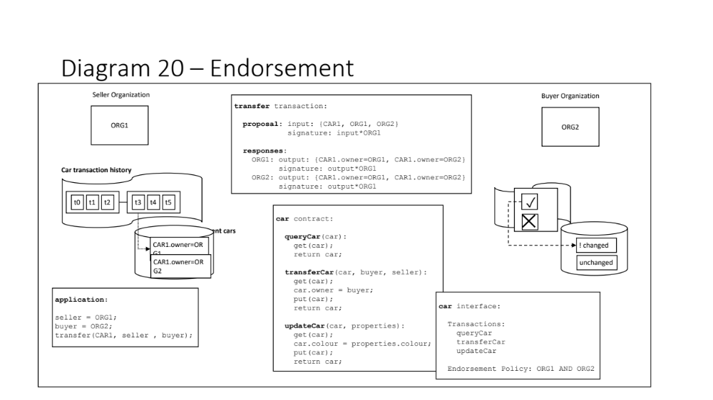
Diagram 20 – Endorsement
Seller Organization
transfer transaction:
proposal: input: {CAR1, ORG1, ORG2}
signature: input*ORG1
responses:
ORG1: output: {CAR1.owner=ORG1, CAR1.owner=ORG2}
signature: output*ORG1
ORG2: output: {CAR1.owner=ORG1, CAR1.owner=ORG2}
signature: output*ORG1
Buyer Organization
ORG1
ORG2
Car transaction history
t0
t1
t2
t3
t4
t5
✓
car contract:
queryCar(car):
get(car);
return car;
transferCar(car, buyer, seller):
get(car);
car.owner = buyer;
put(car);
return car;
updateCar(car, properties):
get(car);
car.colour = properties.colour;
put(car);
return car;
╳
Current cars
CAR1.owner=ORG1
! changed
CAR1.owner=ORG2
unchanged
application:
seller = ORG1;
buyer = ORG2;
transfer(CAR1, seller , buyer);
car interface:
Transactions:
queryCar
transferCar
updateCar
Endorsement Policy: ORG1 AND ORG2

